Slide 1
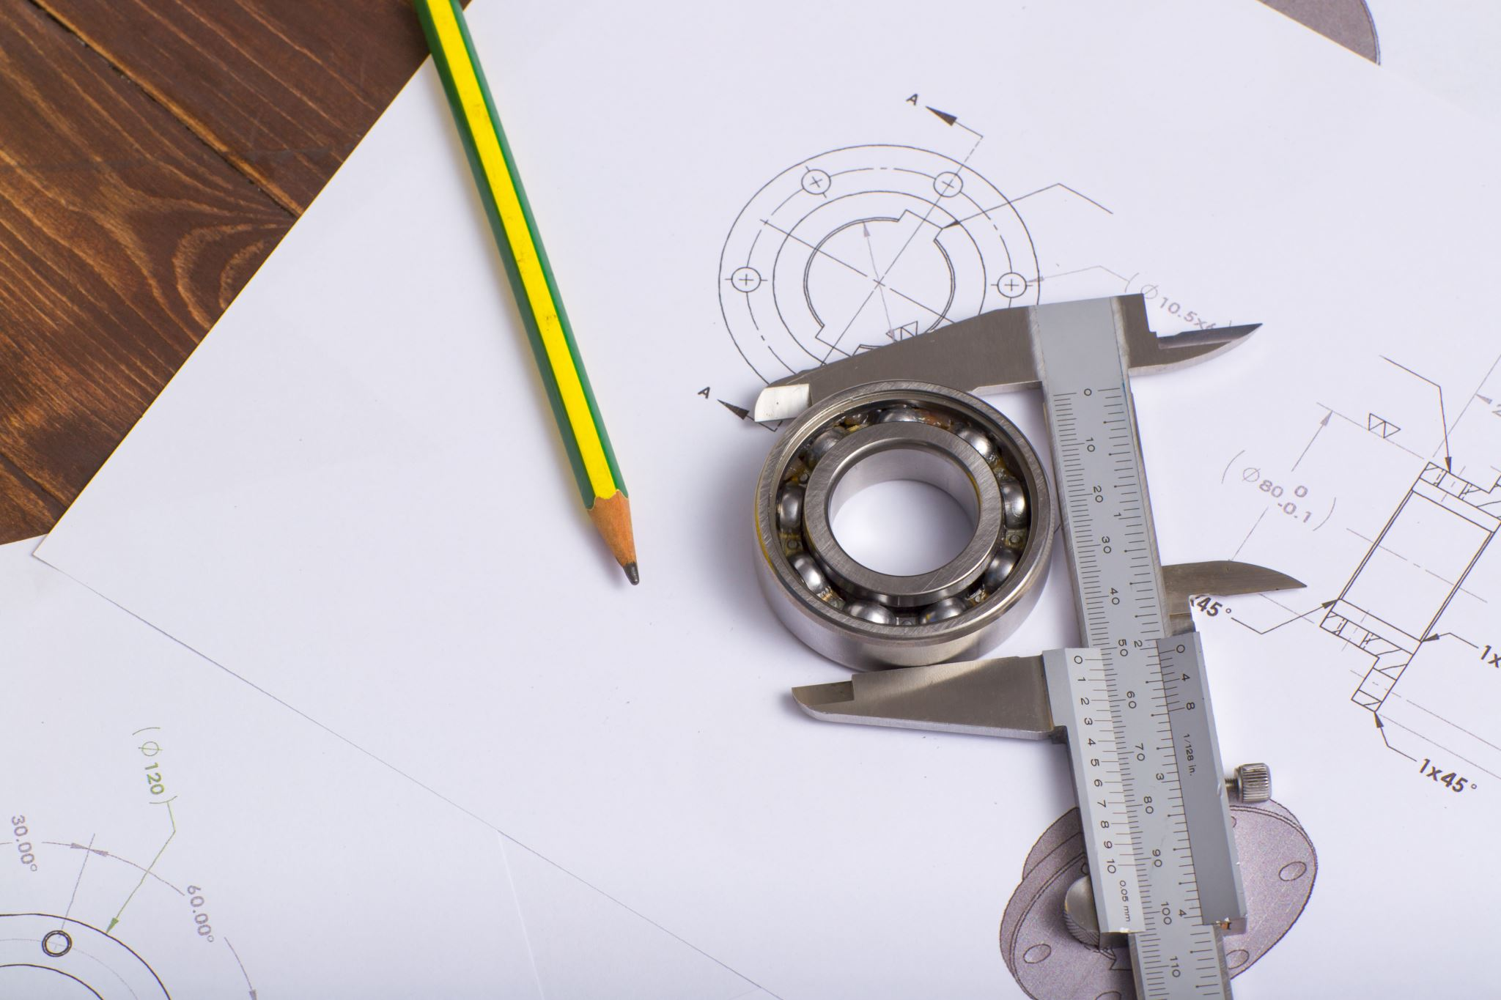
Computer Architecture
Gayan Perera,
Lecturer Faculty of Computing
Dept. of Computer Science & SE
NSBM Green University Town

Slide 2
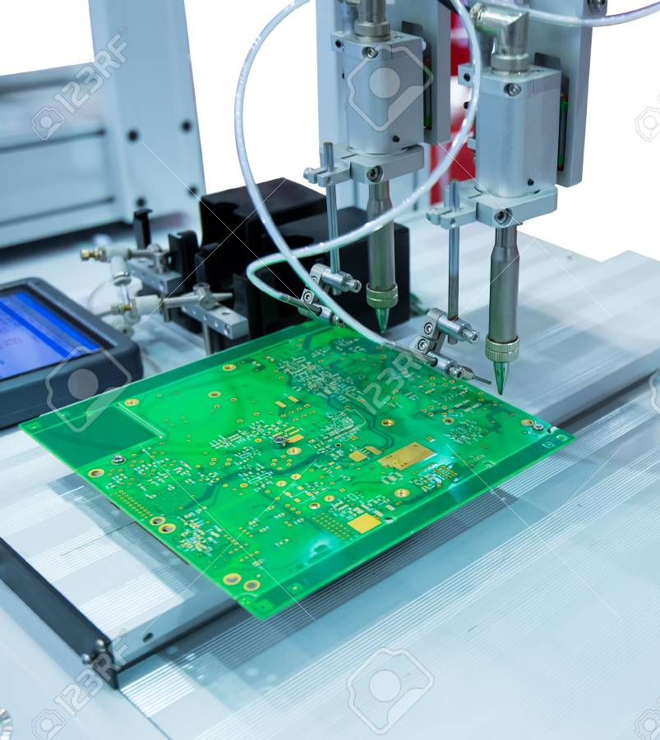
What is an Architecture
In computer manufacturing, computer engineering is a set of rules and methods that describe the functionality, organization, and utilization of computer systems.
Some definitions of engineering define it as describing the where physical and programming model of a computer but not a particular utilization.
In other definitions computer architecture proves instruction set architecture design, microarchitecture design, logic design, and utilization.

Slide 3
Computer Architecture
Computer Architecture = Computer Organization +
Instruction Set Architecture
Computer Organization
HOW the ISA is implemented (physical view)
Instruction Set Architecture (ISA)
WHAT the computer does (logical view)
We will study both in this course

Slide 4
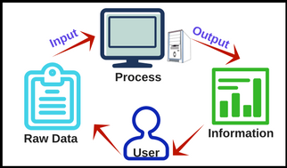
LO 1 : Introduction to the Computer
Computer is an electronical machine designed to process, store, move, and retrieve data.

Slide 5
Data
Things known or accepted as facts which makes the basis of reasoning and calculation
Information in raw or unorganized form (such as alphabets, numbers, or symbols) that refer to, or represent, conditions, ideas, or objects.
“What’s the point of all this data?
Estimates show that we created about 1.8 trillion gigabytes of data in 2011 (take a moment to just think about how much that is). Just one year later, in 2012, we created over 2.8 trillion gigabytes of data! This number is only going to explode further to hit an estimated 40 trillion gigabytes of data creation in just one year by 2020.
Why use valuable resources to generate and collect it

Slide 6
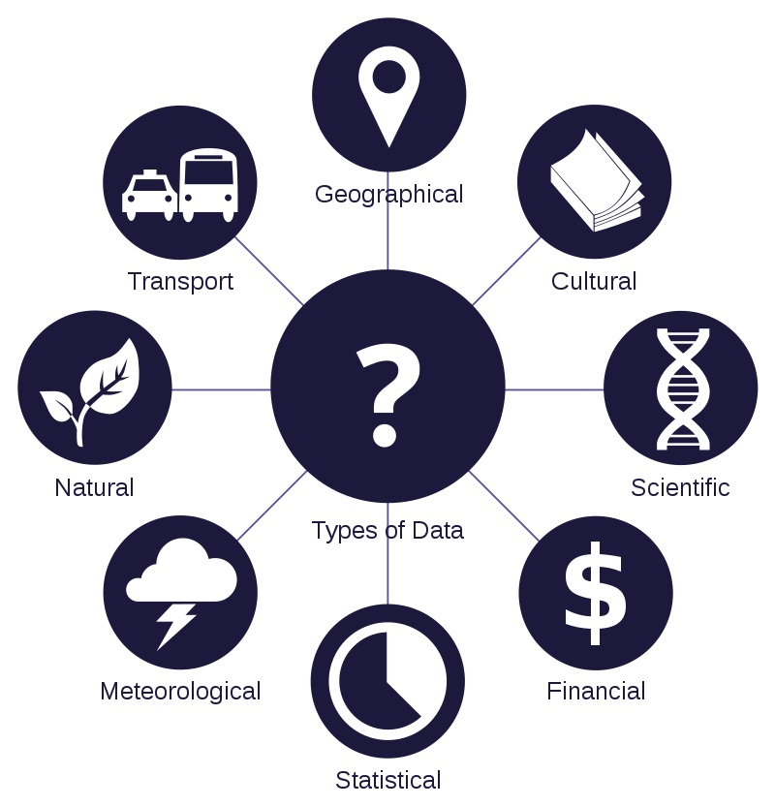
What is Data?
Has quantitative and qualitative aspects
Can be generated from multiple sources such as
Forms
Observations
Occurrences
etc.

Slide 7
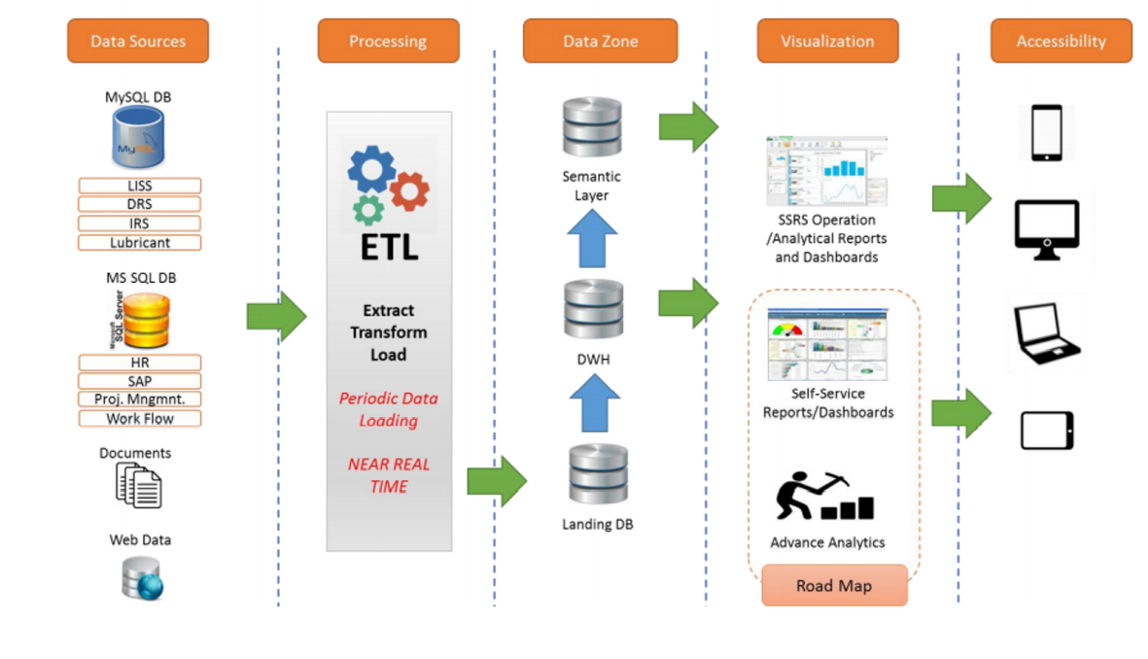
Data Processing

Slide 8
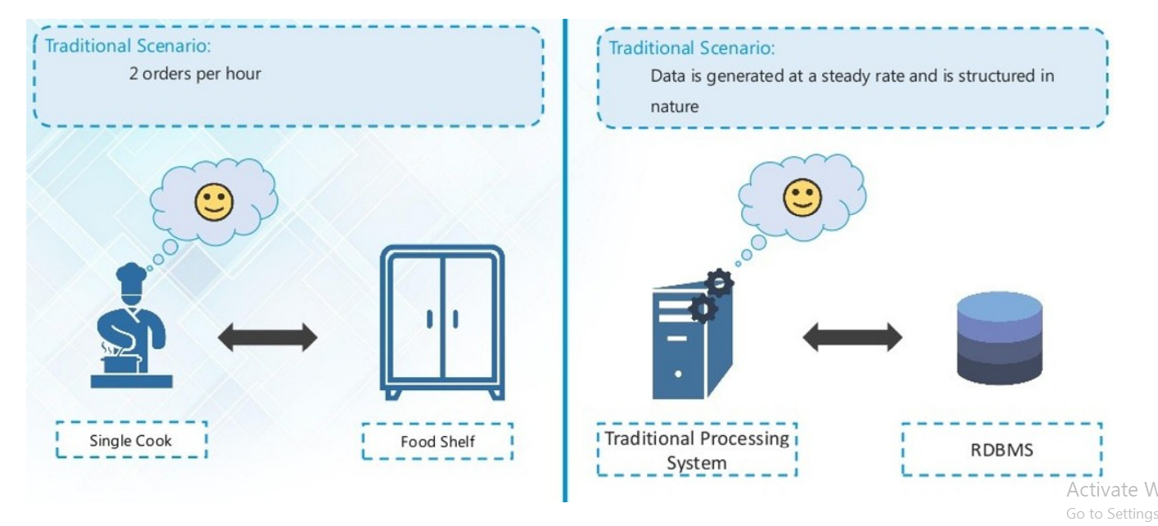
Data Storing & Retrieving

Slide 9
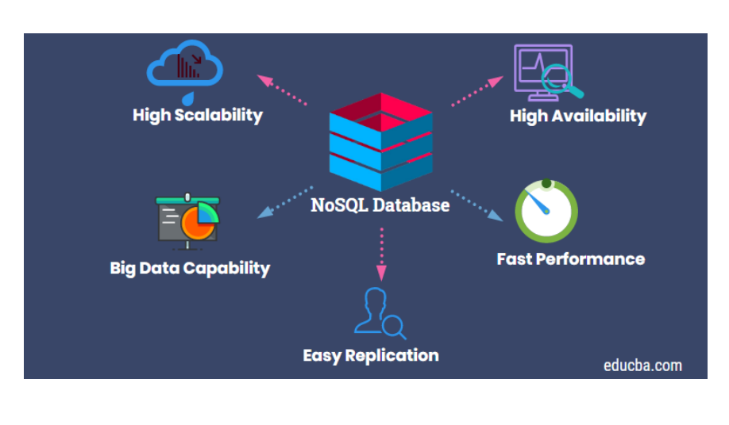
No SQL Databases

Slide 10
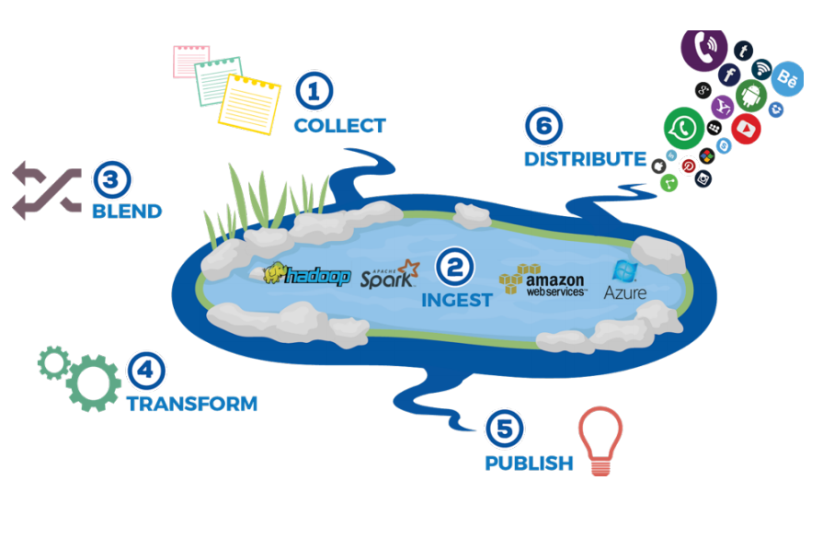
Data Lake
Cater to large volumes of data: companies have large volumes of data that it is either costly and/or sometimes RDBMS/DW can not handle
• Seamlessly integrate diverse data source and formats: rigid structures/architectures of traditional systems cannot cater to different, changing data formats

Slide 11
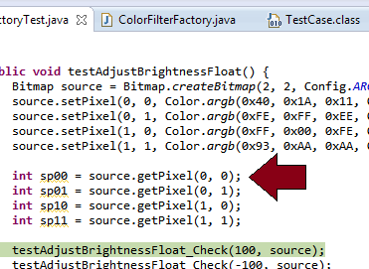
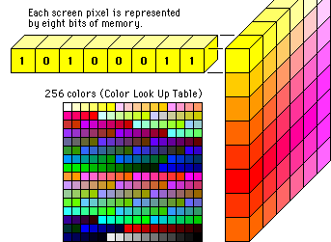
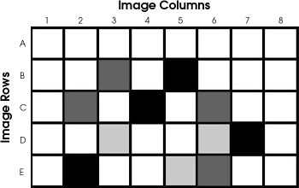
What is data to the computer
Data may be numbers in a spreadsheet, characters of text in a document, dots of color in an image, waveforms of sound, or the state of some system, such as an air conditioner or a CD player.
The computer manipulates the data by performing operations on the numbers.
Displaying an image on a screen is accomplished by moving an array of numbers to the video memory, each number representing a pixel of color.

Slide 12
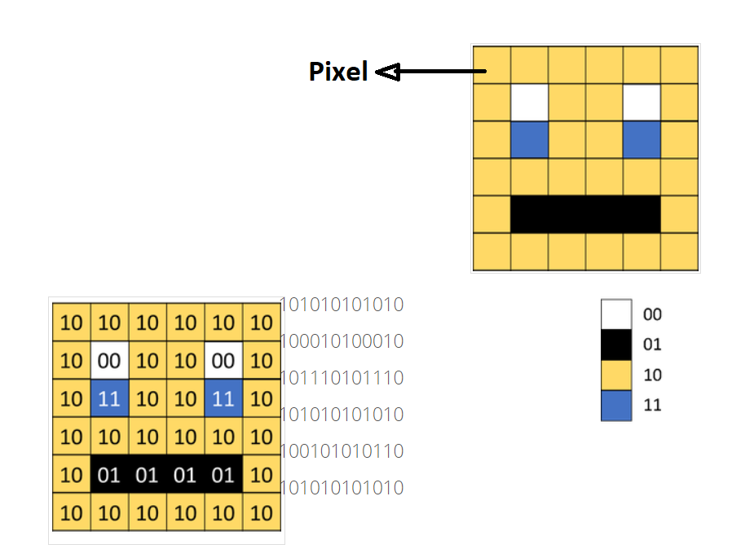
Images
To store an image on a computer, the image is first broken down into tiny elements called PIXELS. The smallest element in a picture or image is called Pixel(in short of Picture Element = Pixel).
Ex: If your image resolution is 1020 x 800(width x height), the total number of pixels is 816,000.

Slide 13
Quick Question
An image is 3072 pixels by 2304 pixels. Calculate following
The total number of pixels in the original image
Number of bytes occupied by this file
If the file size of the jpeg image (in Mb) if the original image was reduced by a factor of 5.
How many uncompressed files of the size calculated in part 2 could be stored in in a 4 Gb memory card.
How many compressed files of the size calculated in part 2 could be stored in in a 4 Gb memory card.

Slide 14
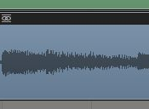
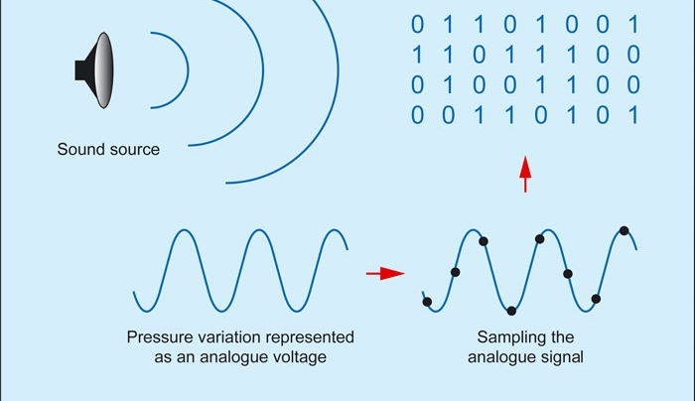
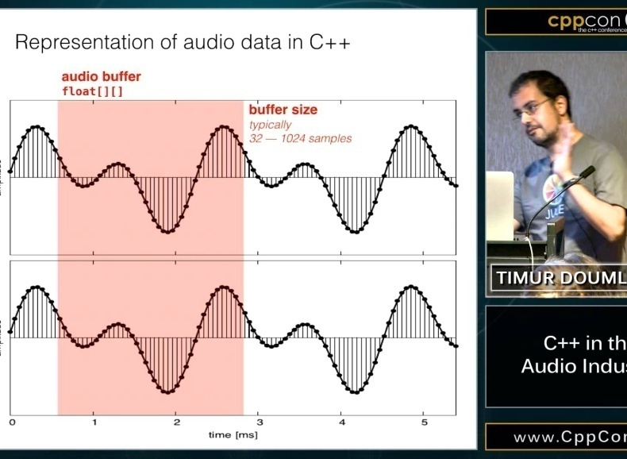
What is Data (Sound)
To play an MP3 audio file, the computer reads an array of numbers from disk and into memory, manipulates those numbers to convert the compressed audio data into raw audio data, and then outputs the new set of numbers (the raw audio data) to the audio chip.
The computer manipulates the data by performing operations on the numbers.

Slide 15
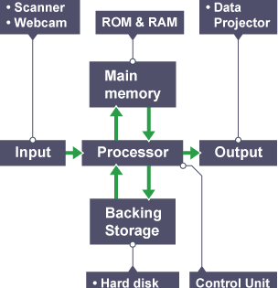
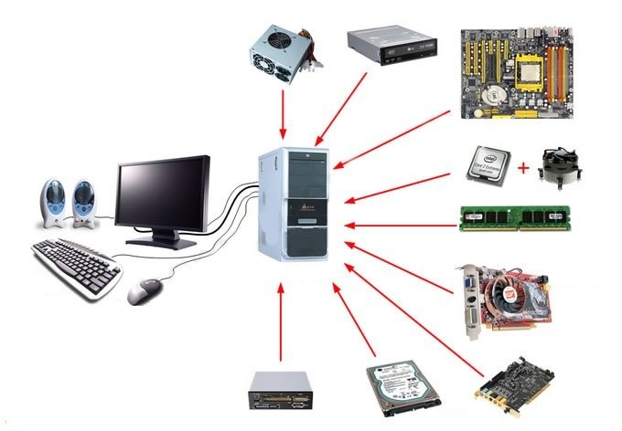
Composition of Computer System
The computer also has memory, often several different types in one system.
The memory is used to store programs while the processor is running them, as well as store the data that the programs are manipulating. The computer also has devices for storing data, or exchanging data with the outside world.
These may allow the input of text via a keyboard, the display of information on a screen, or the movement of programs and data to or from a disk drive.

Slide 16
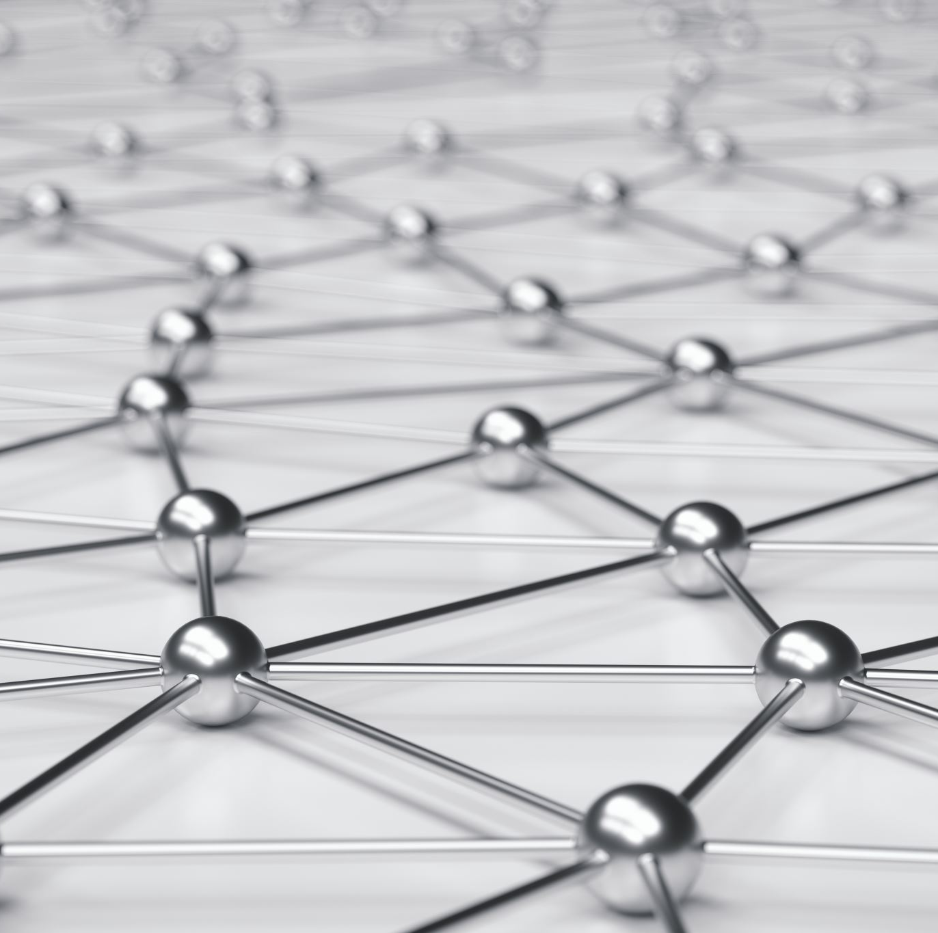
Next Topic
Computer Organization

Slide 17
Thank You !

